Slide 1
PMI Educational Foundation Project Management for Social Good® "What's In It For Me?”
Walter Ginevri, PMI Fellow
PMIEF Board of Directors
26 May 2017 - 5th National Conference for Partners of PMI Kazakhstan Chapter

Slide 2
Learning objectives
Learn about PMIEF as an organization and a key partner for social good programs
Explore a wide range of possibilities of social good programs to added to the core chapter services
Learn the value of social good for project managers (beyond PDU) and chapters
Explore how to build or strengthen the chapter mission and the strategy for social good

Slide 3
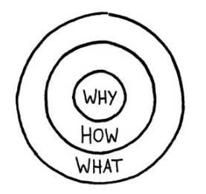
Presentation agenda
Why partner with PMIEF?
How PMIEF will support you?
What PMIEF will give to you?
Why partner with PMIEF?
The Golden Circle
(source: Simon Sinek)

Slide 4
Why PMIEF?
Founded in 1990
Philanthropic arm of PMI
Separately incorporated non-profit organization leveraging project management for social good®
Significant growth over last five years
PMI
51 million
PMs
PMIEF
7 billion people

Slide 5
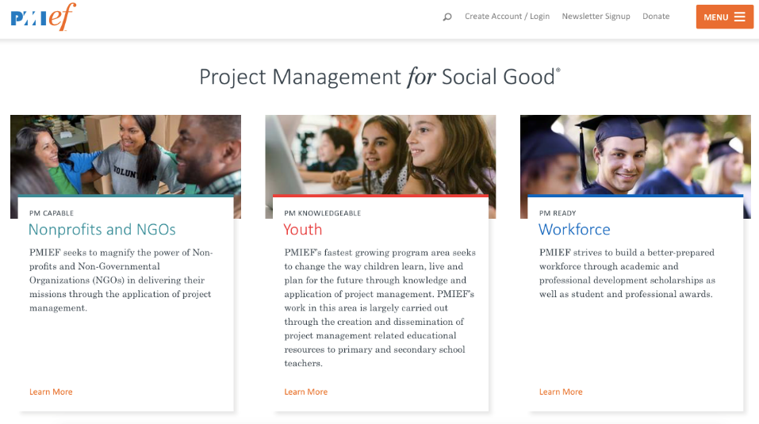
Why promote PMIEF strategic pillars?

Slide 6
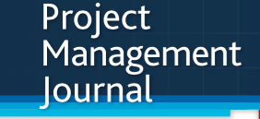
Why promote PM Capable Nonprofits and NGOs?
Main issues of NGOs involved within humanitarian projects
One of the reasons humanitarian aid fails
PM problems in international development.
Make a plan, and communicate it
Lack of project management capacity
Source: Science AAAS by Emily Underwood (2016)
Source: PMI – Project Management Journal (2012)

Slide 7
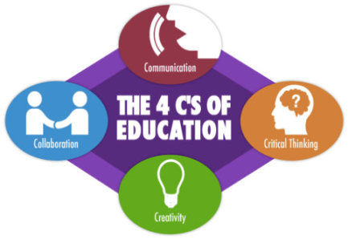
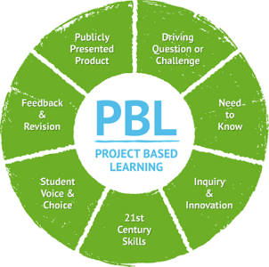
Why promote PM Knowledgeable Youth?
Emerging trends within education and learning processes
Source: P21 – Partnership for 21st Century Skills
Source: BiE – Buck Institute of Education)

Slide 8
Why promote PM Ready Workforce?
Evolution of demand for professionals within job market
95%
of executives
involved in
a survey
Demand for Project Management professionals in the United States
Source: PMI – PM Talent Gap Report (2013)
Project management is the most
important skill for future success
Source: The Economist Intelligence Unit (2009)

Slide 9
Why Chapters should promote PM for Social Good®?
Chapter benefits: increased retention, strengthen brand
Spark interest for the project manager profession
Build the chapter brand and reputation
Increase and retain membership
Member benefits: increase skills, visibility in community
Increase participation in the community
Enable for skill building and increased knowledge
Attracting new volunteers interested in social good work
Community benefits: social good, improve community
Opportunity to give back to the community
Share knowledge with the community
Enabler for change in the community

Slide 10
Presentation agenda
Why partner with PMIEF?
How PMIEF will support you?
What PMIEF will give to you?

Slide 11
How PMIEF and PMI Chapters can build bridges
Non-Profits / NGOs
Young Learners
School Teachers
Students of all ages
PROJECT MANAGEMENT PROFESSION

Slide 12
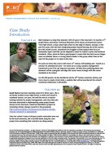
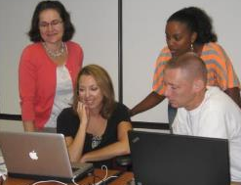
How to build bridges for school teachers
Virtual teacher training program with Boise State University
Online and classroom style training scholarships for teachers
Funding creation of a 3 hour workshop titled PM for K-12 Educators
PM Toolkit for TeachersTM
PM Toolkit
for YouthTM

Slide 13
How to build bridges for young learners
Collaboration with Beacon Prep School in Minnesota
Teaching PM skills as life skills to youth of the poorest townships in South Africa
Annual event involving dozens of Italian primary schools in developing projects

Slide 14
How to build bridges for Non-profits/NGOs
Center for Digital Inclusion (an NGO in Brazil) partners with PMIEF to achieve their mission
Development program of an Italian NGO for the population of the Congo

Slide 15
How to link PMIEF with PMI Chapters
PMI Chapter
PMIEF
PMIEF
Liaison
A PMIEF Liaison is an essential communication link between PMIEF and a PMI chapter for leveraging project management for social good®.

Slide 16
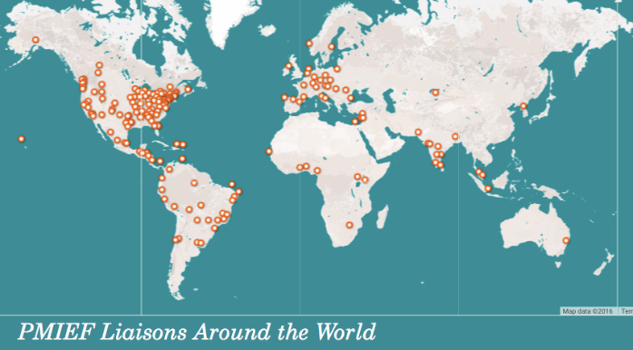
How PMI Liaisons are distributed worldwide
190 of PMI’s Global Chapters have established PMIEF Liaisons
http://pmief.org/community/pmief-liaisons/liaison-resources/register-your-liaison

Slide 17
Presentation agenda
Why partner with PMIEF?
How PMIEF will support you?
What PMIEF will give to you?

Slide 18
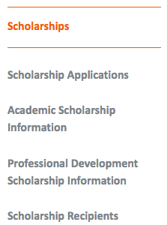
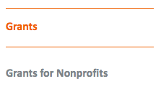
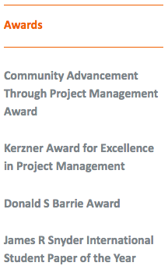
Scholarships, Grants and Awards provided by PMIEF
Today about US$500,000 awarded in scholarships, awards and grants!

Slide 19
For Students: offered to students attending an accredited college or university and studying project management or a related field
For Teachers: offered to primary and secondary school teachers to help enhance the learning experience in their classrooms
For Nonprofits and NGO Staff: offered to employees of nonprofit and NGOs to improve their effectiveness and efficiency
For Professional Development: offered to any professional who wishes to improve their professional capabilities
http://pmief.org/scholarships-grants-and-awards/scholarships

Slide 20
Non-profit (NGOs) Grants: PMIEF advances its mission through the funding of projects that:
raise awareness of project management in global & local communities
introduce and promote the use of project management as a life skill
encourage new ventures related to project management
assure long-term sustainability of humanitarian projects
recognize leadership in project management
Special 2015 Nonprofit Grant Initiative: Disaster Management Grants Initiative
http://pmief.org/scholarships-grants-and-awards/grants

Slide 21
The James R. Snyder International Student Paper (ISPY) of the Year: available to undergraduate and graduate students for research papers
The Donald S. Barrie Award: available to undergraduate and graduate students and practitioners for research papers focused on PPPM
The Kerzner Award: available to project managers who most emulate the professional dedication and excellence of Dr. Harold Kerzner
Community Advancement Through Project Management Award: for Corporations/Government Agencies, PMI Chapters, and individual PMs who transfer PM knowledge to a nonprofit organization’s staff
http://pmief.org/scholarships-grants-and-awards/awards

Slide 22
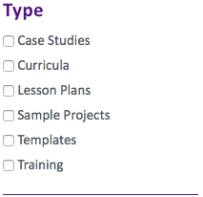
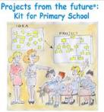
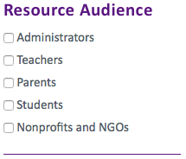
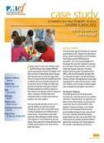
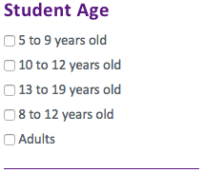
Learning Resources available through PMIEF website
PM Toolkit
for Teachers
Careers in Project
Management
Projects from the future:
Kit for Primary Schools
Project Management
Skills for Life
Project Management Toolkit for Youth
Case-Studies on PM Programs
Project Management
for Nonprofits
PM Youth Fiction
Books

Slide 23
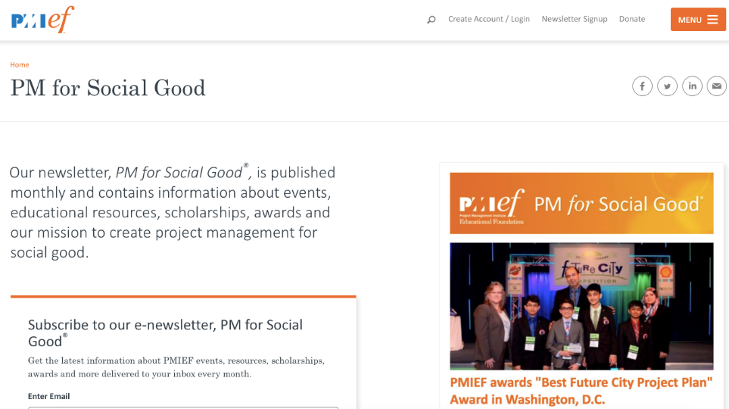
Don’t forget to sign for PMIEF’s e-Newsletter
Sign up on PMIEF.org → http://pmief.org/#newsletter-signup

Slide 24
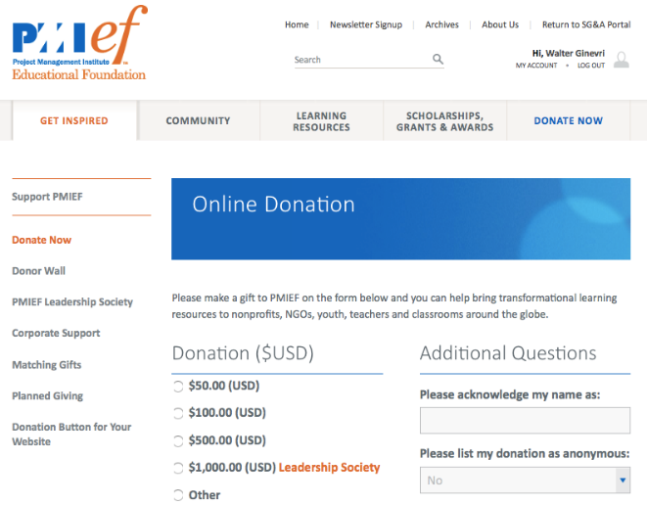
Last but not least: What you can give to the PMIEF?
“You can give without loving, but you cannot love without giving”.
Amy W. Carmichael (Protestant Christian missionary in India)

Slide 25
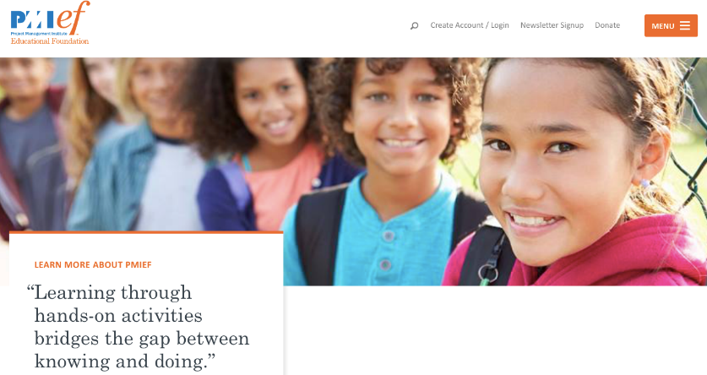
Thanks for your interest in learning more about PMIEF. Together we can do great things!
Walter Ginevri, PMI Fellow
PMIEF Board of Directors
walter.ginevri@bod.pmief.org

